Slide 1
Tasks

Slide 2
TK.1 – Create a Rules Utils
Any facilitator tools should be set in this utils library
Use it to create SafiraRules
Share it with other to expand rules

Slide 3

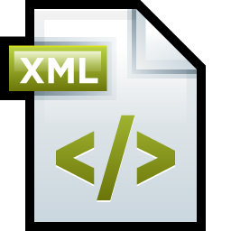
TK.2 – Create a Metadata Generator
Rule1.cs
Metadata.xml
Rule2.cs
Metadata Generator Tool
Rule3.cs
Every rule library needs to have a Metadata.xml file to describe every rule.
The tool makes it so that any developer only needs to worry about making Rule classes in c#.

Slide 4
Ideas for Rules

Slide 5
ID.1 – Deploy it with Nuget
How:
Create a Nuget internal server
Deploy the SafiraRules ( RuleSet + Library )
Each new project adds reference to the SafiraRules package
Pros:
The reference from the RuleSet to the library is static
Possibly every new machine working on the project only needs to update from svn
By: VBT

Slide 6
ID.2 – Run it with MSBuild
How:
In the msbuild command add the following property: “/p:RunCodeAnalysis=true;CodeAnalysisRuleSet=<ruleset-name>.ruleset”
Pros:
Discover rule breaking in projects without using visual studio.
Cons:
The (ruleset+library) must exist in every project, if the msbuild is used to build a whole solution.

Slide 7
ID.3 – Use it for .cshtml
HOW?

